Slide 2
CHAPTER#11
EVALUATING AND SELECTING THE FACILTIES PLAN
10/12/2014

Slide 3
GROUP MEMBERS
Sibghat Ullah Agha 11-IE-38
M.Arbab Jahangeer 11-IE-45
Muhammad Luqman 11-IE-64

Slide 4
Evaluating Facilities Plans
Listing advantages and disadvantages
Ranking
Weighted factor comparison(WFC)
Economic comparison

Slide 5
1.Advantages and disadvantages
Pros and cons for two functional areas in a
distribution centre are explained below
1.Receiving
2.Restock/Putaway process

Slide 6
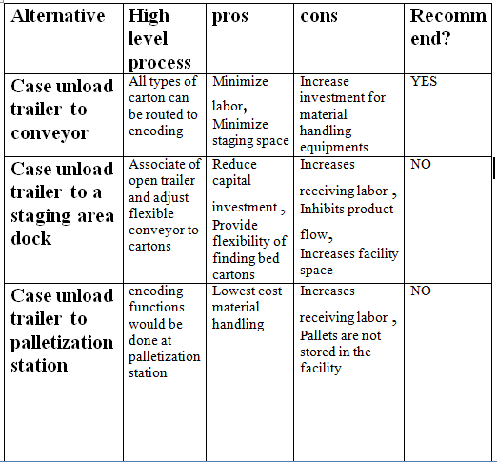

Slide 7
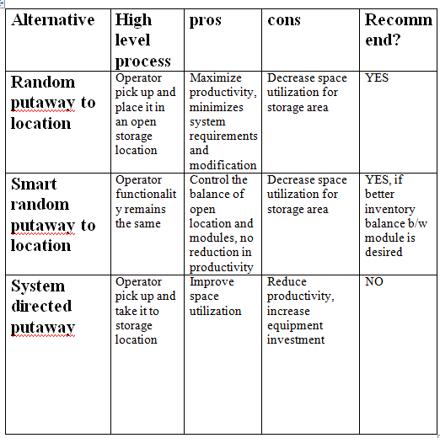

Slide 8
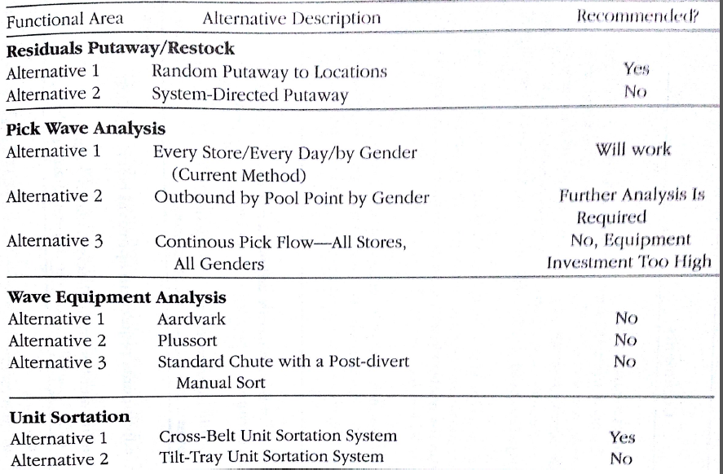

Slide 9
2.Ranking
All alternatives can be compared against a common set of factors.
After using ranking procedure, the results must be integrated to allow a selection to be made.
Ranking yield too much information.

Slide 10
Factors for Ranking
Degree of automation
Availability of required equipments
Quality of product and risk of damage to material
Ease of maintenance of equipments
Optimize space utilization
Working conditions and employee satisfaction in facility

Slide 11
3. Weighted Factor comparison
Procedure:
Assign weight to each factor based on its importance
Assign numerical score to each alternative based on its performance
Multiply the weight with the numerical score of each factor
Sum all the products of each alternative
Select one alternative with its highest score

Slide 12
Weighted factor comparison form

Slide 13
Consideration of factors for WFC
Initial investment required
Annual operating cost
Returned on investment (ROI)
Payback period
Flexibility in installed system
Space utilization
Safety and house keeping
Working conditions and employee satisfaction
Volume of spare parts required to stock

Slide 14
Conti…
Quality of product and risk of damage to material
Availability of equipments needed
Degree of automation
Software requirements
Ease of maintenance

Slide 15
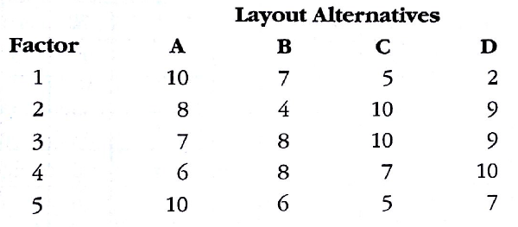

Slide 16
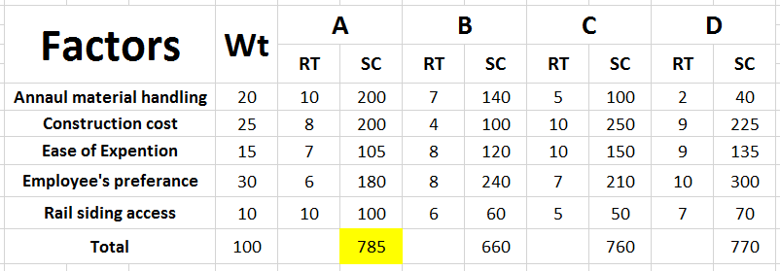

Slide 17
4.Economic comparison
The following systematic economic analysis
technique (SEAT) can be used to justified
investment:
Specify the feasible alternative to be compared
Define the planning horizon to be used
Estimate the cash flows for each alternative
Specify the discount to be used
Compare the alternative using a discounted cash flow method (DCF)
Perform supplementary analysis
Select the preferred alternative

Slide 18
Comparing Investment Alternatives
Following rules are applied when comparing investment alternatives
To move a cash flow forward in time by one time period multiply the magnitude of cash flow by the quantity
Where is the time value of money
To move a cash flow backward in time by one time period divide the magnitude of cash flow by the quantity

Slide 19
The process of multiplying and dividing cash flow by the quantity is called compounding and discounting respectively.
The overall sum process of converting cash flows to single-sum equivalents(present and future values) or equivalent annual series(annual value) is called a discounted cash flow process(DCF).

Slide 20
DCF Methods
Net present value(NPV)
Internal rate of return(IRR)
Annual worth(AW)
Future worth(FW)
Discounted payback period(DPP)

Slide 21
Facilitate The Performance
Formula:
Where denotes the value of cash flow at time zero
denotes the value of cash flow at time t
denotes time value of money

Slide 22
Sample Spreadsheet

Slide 23
Example 11.4
Performing discounted cash flow calculations:
A conveyor is purchased for $10,000.Its
application yields a net annual cost savings of
$3,000 per year for a five year period. What are
the net present value, the net future value and
the internal rate of return for the investment if a
discount rate of 10% is used and a zero salvage
value for the conveyor is assumed?

Slide 25
Selecting The Preferred Alternatives
Speak the language of listener.
Do not confuse unfavorable results with destiny.
You get what you pay for; don't be penny-wise and dollar-foolish.
Profit maximization is not always the “name of game” but “selling” is!
The less you bet, the more you stand to lose if you win.

Slide 26
Conti…
Your proposal will be only one of many submitted and many will not be funded.
Remember the golden rule: those with the golden make the rules!
Pre-sell your recommendation!
Obtain the support of the users of the recommended system.
Timing is everything!

Slide 28
?
Any Questions

